Slide 1

Building
TRUST
Notes:
Good morning. We will be talking about a very important aspect of Leadership. Looks very intangible and undefinable.
Let me ask you a question. Think of someone in your office (could be at offshore or onsite), who you trust. Let me know what is that you trust them about – let me hear it from each one of you.
Picture from Forbes.com – Leadership conundrum

Slide 2
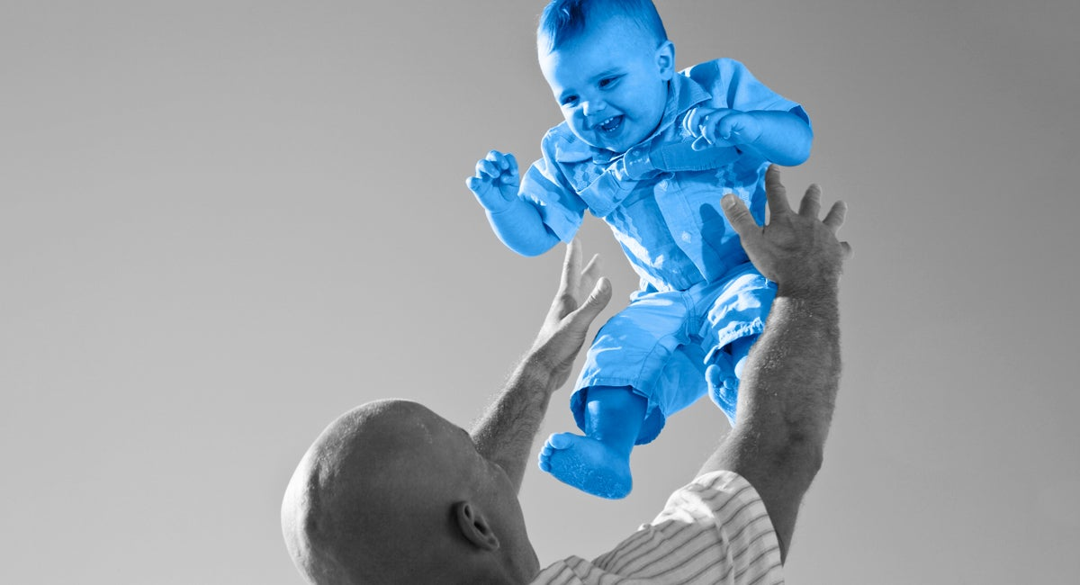
central part of all relationships
an expectation of a behavior
a belief that someone is dependable
a feeling of safety & confidence
Notes:
What is trust?
Oxytocin.
Smile / Staring faces – Who would you trust
Connectedness / Invisible Bonding like Munnabai MBBS Kattipudi vaidhyam

Slide 3


Notes:
BES – Leaders are sincere or trusting or trustworthy
Once you created the personal branding of the trust, then, the branding (trust) can be carried forward for other activities also.

Slide 4

Personal Branding
TRANSFORMATION
Notes:
Picture from aimhighafrica.com
When you are driving transformation, it helps if you have a personal branding.

Slide 5
TRUST
as a brand builder
Notes:
Trust is one of the ways personal branding can be built.
Benefits of Trust:
Increased retention
Higher productivity
Less stress
More energy
Increased engagement – (emotions and relationships)
Knowledge sharing is better when team members trust each other
Team members would invest more of their time in your projects / activities.

Slide 6
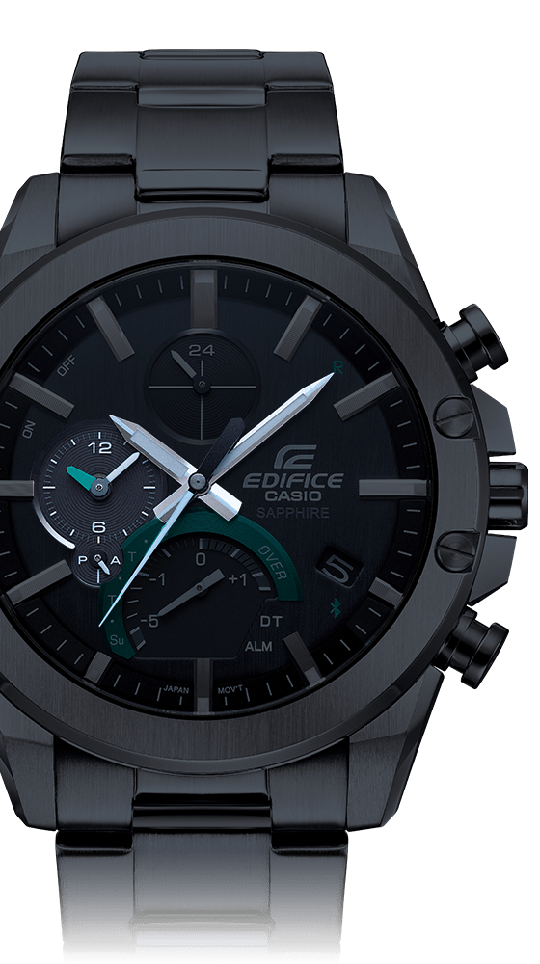
TIME
commitment
Notes:
Do you complete the review that you promised your team member by 2 pm? Did you give the inputs for the proposal that were asked by 5 pm? Did you show up in the meeting at 11 am? Did you finish the meeting on time?
If you need to break a commitment, communicate as early as possible.
What happens when you do this? You show that you care for others’ time. You respect others’ time. You are compassionate about others.

Slide 7
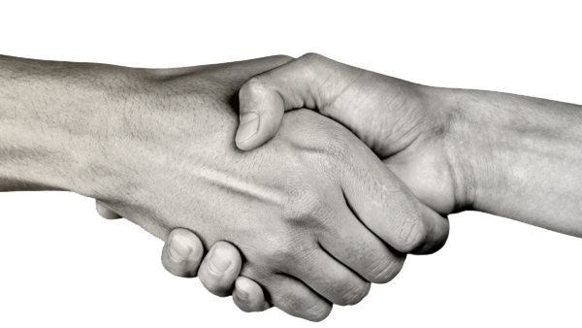
PROMISE
credibility
Notes:
Giving someone a transfer that you promised. Taking care of some work for a colleague when he is absent.
Buying something to your kids as promised. Taking them to a vacation or shopping mall over the weekend?
You show that you care for others. You are showing that you are having integrity.

Slide 8

SKILL
capability
Notes:
Do you trust your spouse? If you are not well, she or he will take care of you well. What if you need to be operated upon? Would you give the surgical knife to your spouse?
Who would you trust in giving a technical task to in your team? A skilled person vs fresh graduate? Skilled person who has joined or skilled person who has demonstrated his or her skills already. Why?

Slide 9
Tiny
TRUST
to develop big trust
Notes:
There are different types of managers – Micro managers who give the task and keep checking it with you every 15 mins. Macro managers forget about it. Insecurity can be there.
Follow-up is something different.
All three are required to develop trust. Just skill is not enough (does the person have the right skill? Yes). Just keeping up the promise is not enough (Was it done? Yes). Just time alone is not enough (Was it done within the time? Yes). When all three are in place, you have a perfect recipe for building the trust.

Slide 10
Tiny
Building
TRUST
TT Activity 1
FJP
in MagiqSpark app
fractal
TT (Tiny Trust)
habit
Completing the task assigned.
Attending meetings on time.
Starting / Ending meetings on time
Notes:
We are good at identifying problems. Even giving solutions. Most of the times, we complain. Find out who should have done and go all out blaming them.
To start building trust, we have to make a shift in our thinking or actions. Sukumar has been talking about it. What is it?
How many of you attend meetings on time?

Slide 11
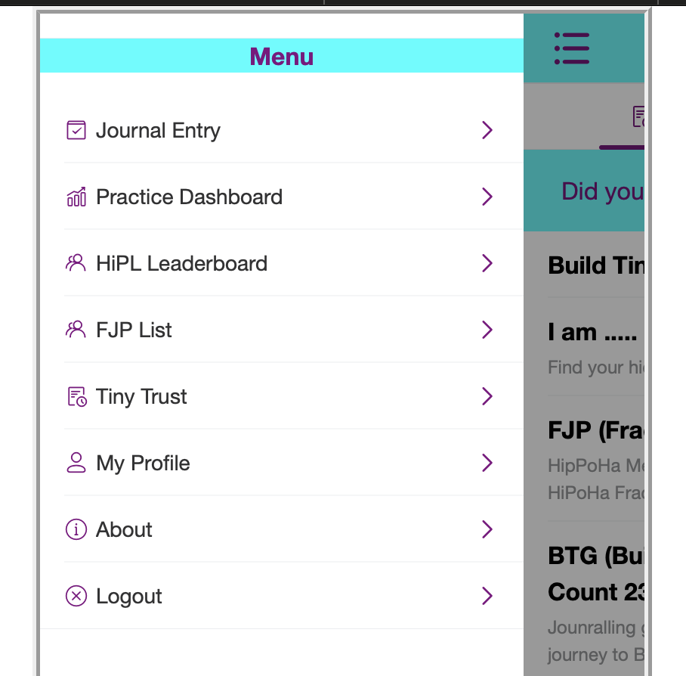
Tiny
Building
TRUST
TT Activity 2
Notes:
For others
You can assign tasks to others and have them complete it.

Slide 12



Levels of
TRUST
L1
L2
L3
TIME
AGENDA
OTHERS
Notes:
L1 – Starting & Ending the meeting on time
L2 – L1+Publishing the agenda and sticking to the agenda
L3 – Ensuring the time and agenda for meetings organized by others also.

Slide 13



Levels of
TRUST
personal branding
trust building at different levels
Notes:
As you develop trust and move across the levels, your personal brand increases too.

